Slide 1
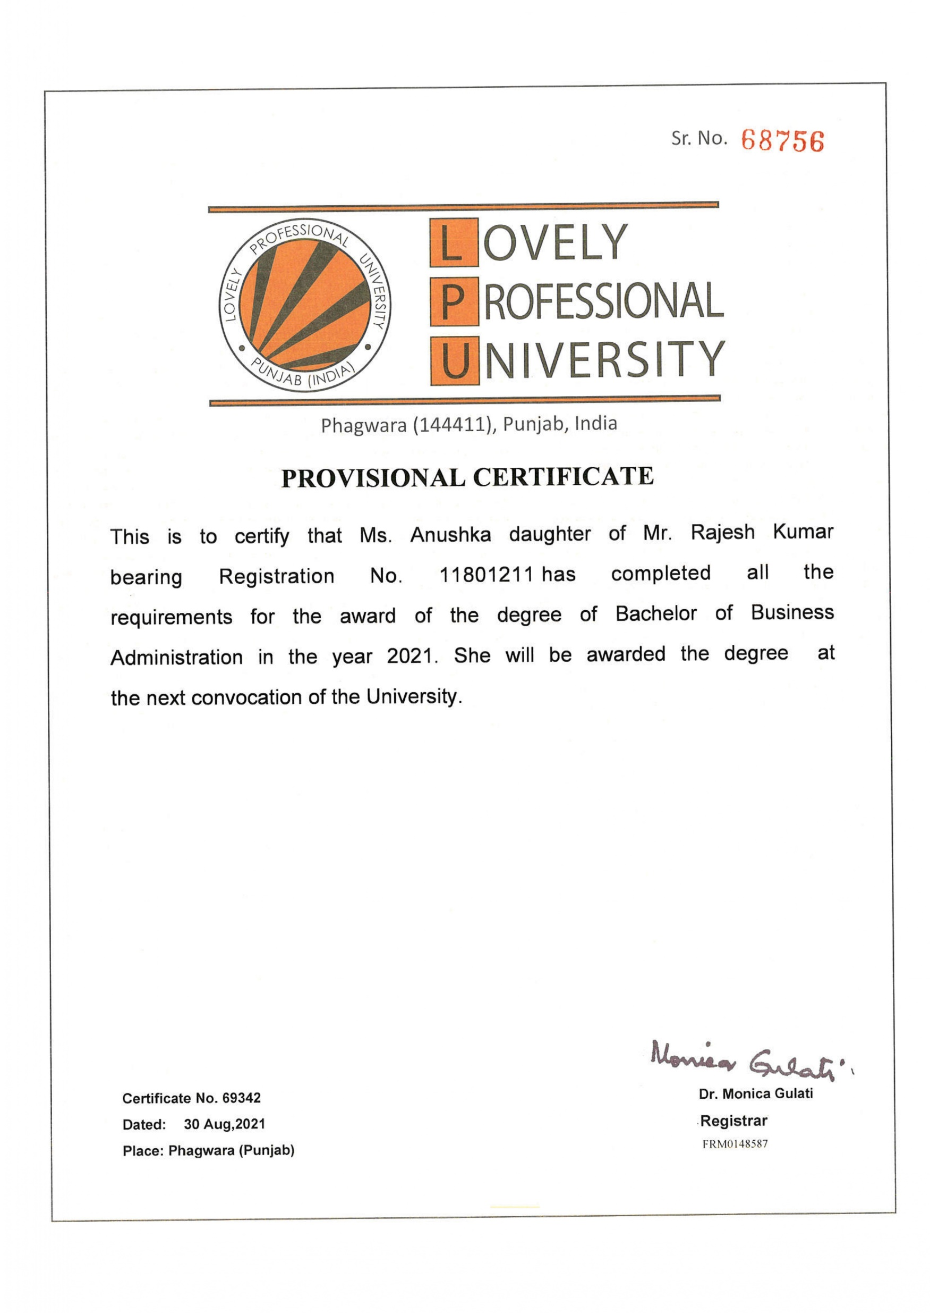


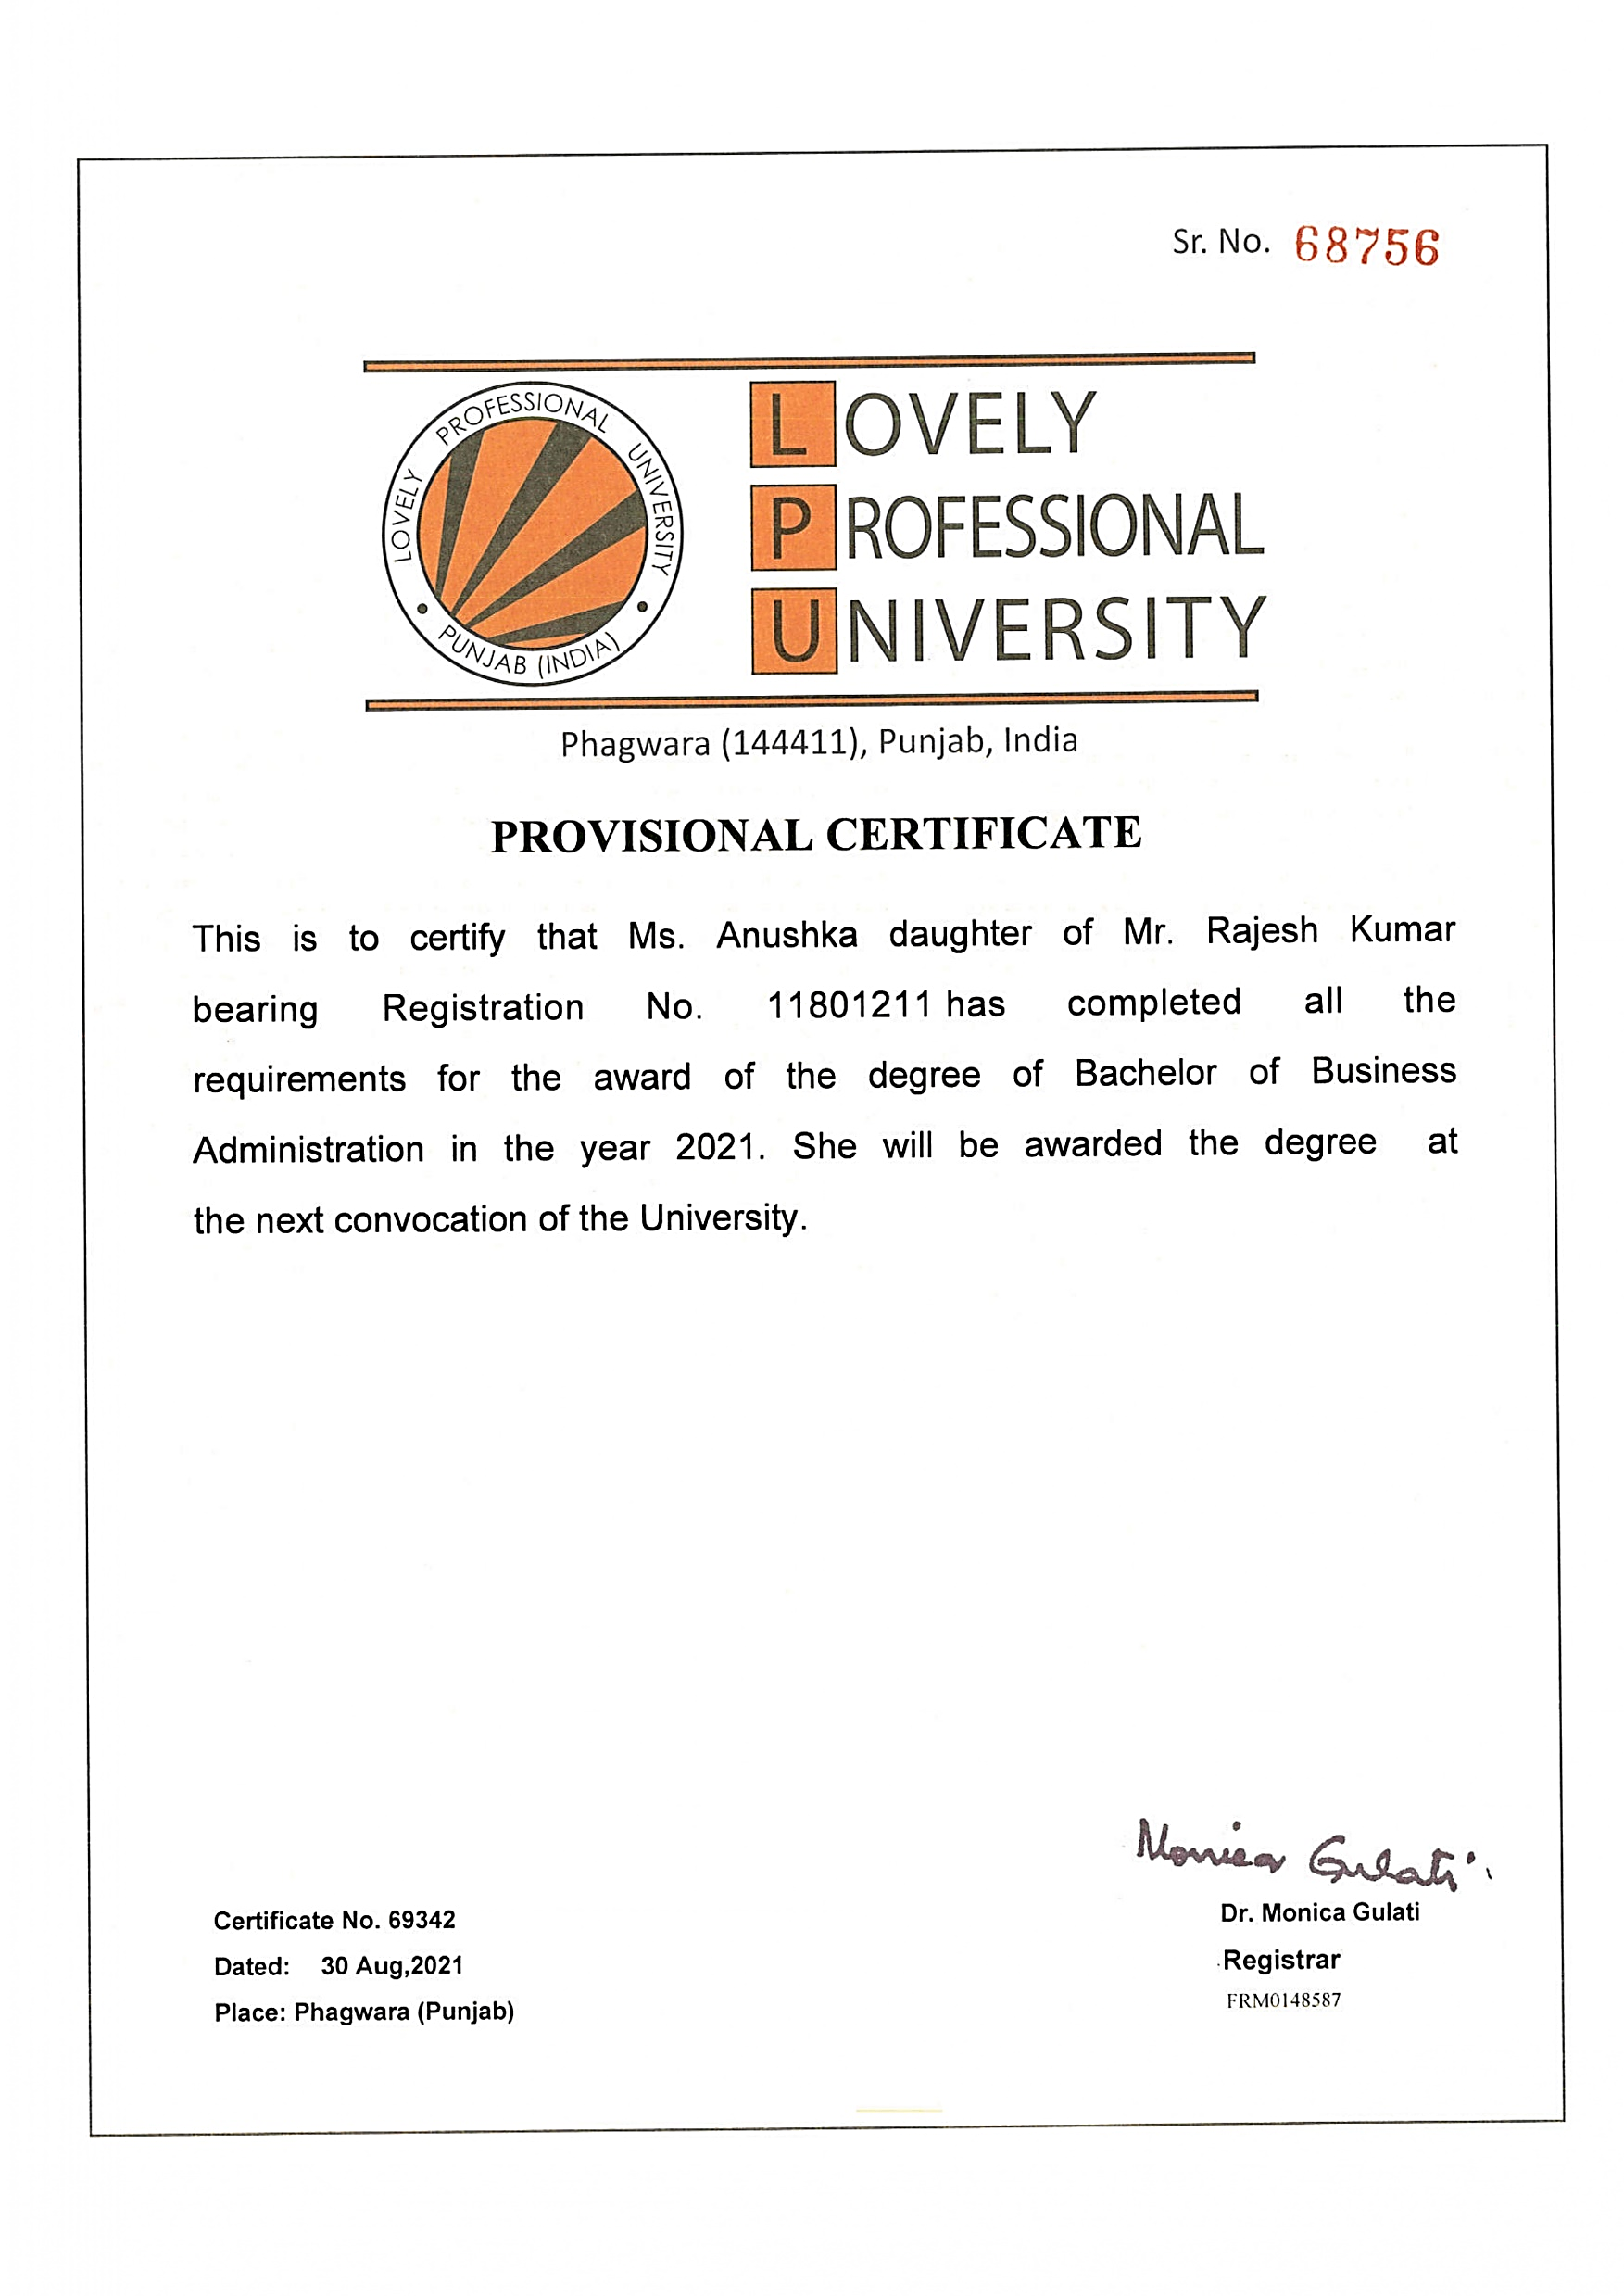
Sr. No.
Phagwara (144411), Punjab, India
PROVISIONAL CERTIFICATE
This is to certify that Mr. Gurpreet Singh Son of Mr. Jagtar Singh bearing Registration No. 11801056 has completed all the requirements for the award of the degree of Bachelor of Business Administration in the year 2020. He will be awarded the degree at the next convocation of the University.
Certificate No. 58343
Dated: 30 Aug,2020
Place: Phagwara (Punjab)
Dr. Monica Gulati
Registrar
FRM048879

Slide 2
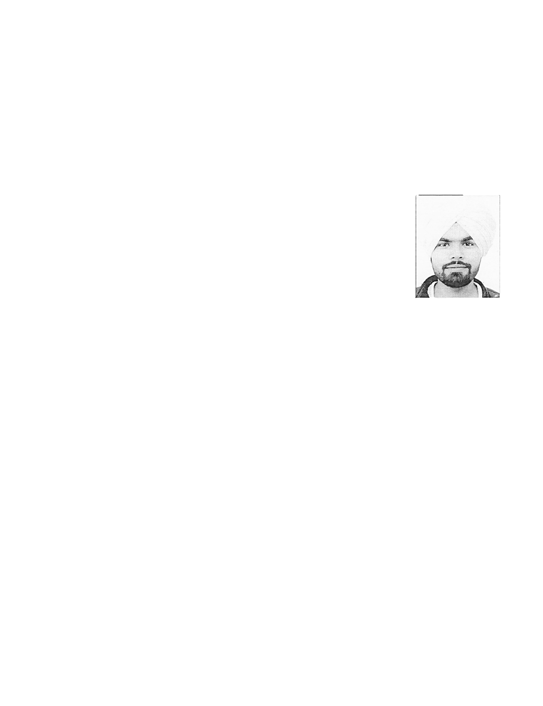
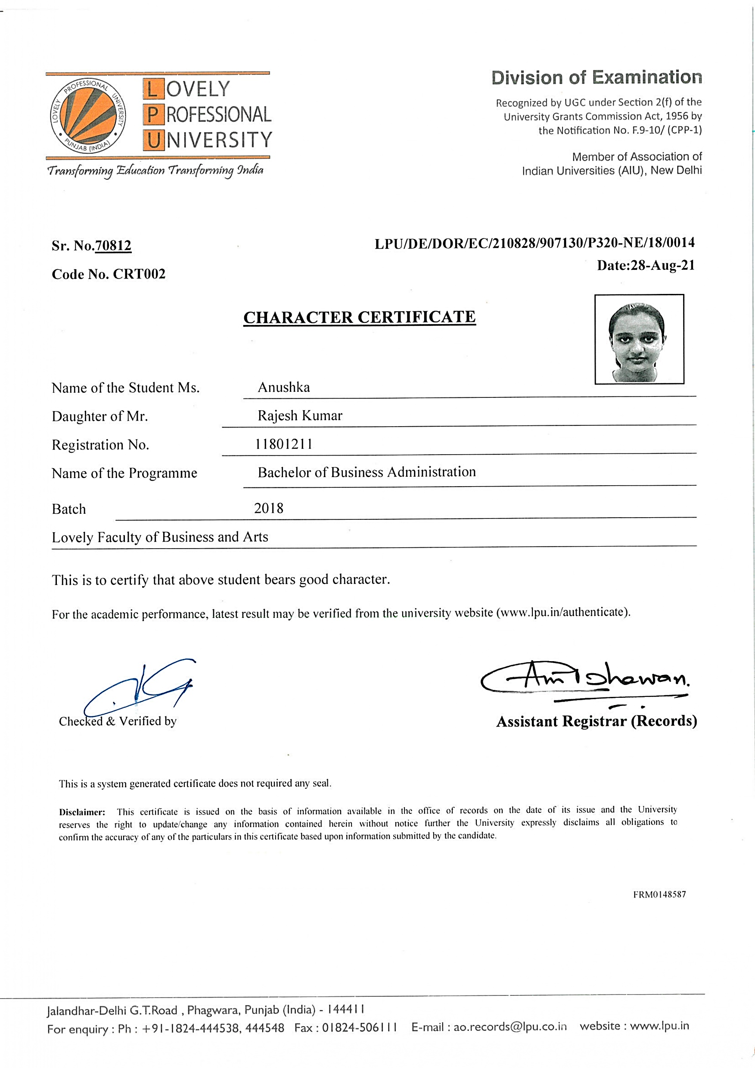
Division of Examination
Recognized by UGC under Section 2(f) of the
University Grants Commission Act, 1956 by the Notification No. F.9-10/ (CPP-1)
Member of Association of
Indian Universities (AIU), New Delhi
Sr. No.68017
Code No. CRT002
LPU/DE/DOR/EC/20898/905280/P210-ND/11/0018
Date: 28-Aug-20
CHARACTER CERTIFICATE
Name of the Student Mr. Gurpreet Singh
Son of Mr. Jagtar Singh
Registration No. 11801056
Name of the Programme Bachelor of Business Administration
Batch 2017
Lovely Faculty of Business and Arts
This is to certify that above student bears good character.
For the academics performance, latest result may be verified from the university website (www.lpu.in/authenticate).
Checked & Verified By
Assistant Registrar (Records)
This is a system generated certificate does not required any seal.
Disclaimer: This certificate is issued on the basis of information available in the office of records on the date of its issue and the University reserves the right to update/change any information contained herein without notice further the University expressly disclaims all obligations to confirm the accuracy of any of the particulars in this certificate based upon information submitted by the candidate
FRM048879
Jalandhar-Delhi G.T.Road , Phagwara, Punjab (India) – 144411
For enquiry : Ph : +91-1824-444538, 444548 Fax : 01824-506111 E-mail : ao.records@lpu.co.in website : www.lpu.in

Slide 3

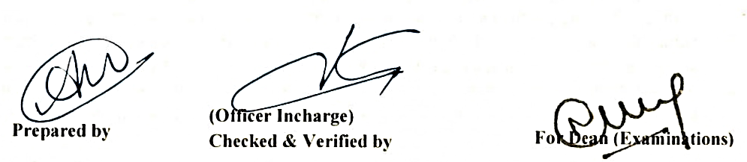
LOVELY PROFESSIONAL
LOVELY PROFESSIONAL
LOVELY PROFESSIONAL
Jalandhar-Delhi G.T. Road, Phagwara, Punjab (India)-144411
Established by the State Legislature of Punjab through the Lovely Professional University Act and Recognized by UGC under Section 2(f) of the UGC Act,1956
Academic Transcript
Student Name : Gurpreet Singh
Registration no. : 11801056
Father’s Name : Mr. Jagtar Singh
Mother’s Name : Ms. Baljeet Kaur
Programme : Bachelor of Business Administration
Mode : Online Education Mode
Date of initial registration : August,2017
TERM-I TGPA : 7.20 Equivalent percentage : 72.00 %
S.No. | Course | *Credits | *Grade
1 | CAP286 :: WORKSHOP ON COMPUTER APPLICATIONS | 2 | O
2 | ECO113 :: BUSINESS ECONOMICS | 5 | B
3 | MGN101 :: MANAGEMENT PRINCIPLES AND ORGANISATIONAL BEHAVIOUR | 5 | B+
4 | MGN303 :: BUSINESS ENVIRONMENT | 5 | B+
5 | PEL103 :: COMMUNICATION SKILLS | 3 | A
TERM-II TGPA : 6.73 Equivalent percentage : 67.30 %
S.No. | Course | *Credits | *Grade
1 | ACC103 :: FINANCIAL ACCOUNTING | 5 | B+
2 | HRM101 :: HUMAN RESOURCE MANAGEMENT | 4 | B+
3 | MGN251 :: WORKSHOP ON EXCEL MODELLING | 1 | B+
4 | MGN253 :: BUSINESS ETHICS | 3 | B+
5 | PEL114 :: BUSINESS COMMUNICATION SKILLS-I | 3 | B+
6 | QTT201 :: QUANTITATIVE TECHNIQUES | 6 | B
TERM-II TGPA : 7.48 Equivalent percentage : 74.80 %
S.No. | Course | *Credits | *Grade
1 | ACC205 :: COST AND MANAGEMENT ACCOUNTING | 6 | B
2 | CHE110 :: ENVIRONMENTAL STUDIES | 4 | A
3 | MGN321 :: PROJECT | 2 | A
4 | MKT201 :: ESSENTIALS OF MARKETING | 5 | A
5 | PEA215 :: ANALYTICAL SKILLS-I | 3 | B+
6 | PES201 :: SOFT SKILLS | 3 | A+
TERM-II TGPA : 7.70 Equivalent percentage : 77.00 %
S.No. | Course | *Credits | *Grade
1 | ACC306 :: FINANCIAL STATEMENT ANALYSIS | 4 | B+
2 | BSL201 :: LEGAL ASPECTS OF BUSINESS | 5 | B
3 | FIN302 :: BASIC FINANCIAL MANAGEMENT | 5 | A+
4 | MGN206 :: RESEARCH METHODOLOGY | 6 | B+
5 | MGN235 :: WORKSHOP ON CREATIVITY AND INNOVATION | 2 | A+
6 | MGN358 :: E-BUSINESS | 5 | A+
Certificate No. : D1011278
Date of issue : 04-Jun-2020
Place : Phagwara (Punjab)
Page 1 of 2

Slide 4
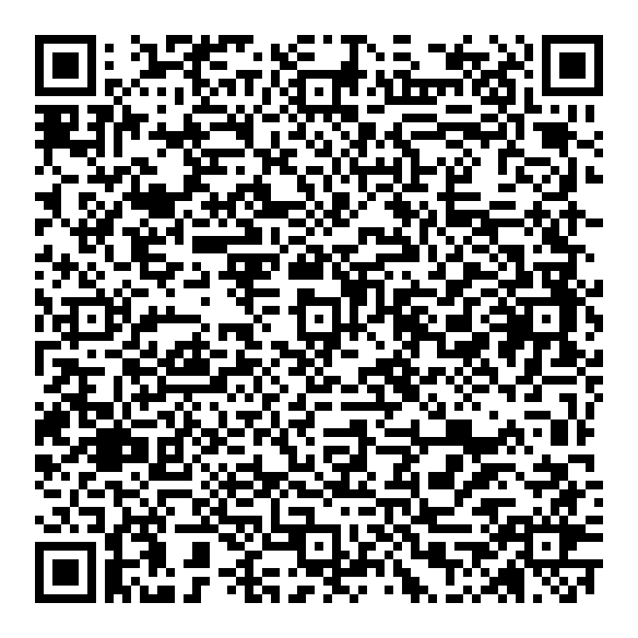
LOVELY PROFESSIONAL
LOVELY PROFESSIONAL
LOVELY PROFESSIONAL
Jalandhar-Delhi G.T. Road, Phagwara, Punjab (India)-144411
Established by the State Legislature of Punjab through the Lovely Professional University Act and Recognized by UGC under Section 2(f) of the UGC Act,1956
Academic Transcript
Student Name : Gurpreet Singh
Registration no. : 11801056
Father’s Name : Mr. Jagtar Singh
Mother’s Name : Ms. Baljeet Kaur
Programme : Bachelor of Business Administration
Mode : Online Education Mode
Date of initial registration : August,2017
TERM-V TGPA : 7.41 Equivalent percentage : 74.10 %
S.No. | Course | *Credits | *Grade
1 | CIV882 :: ENVIRONMENTAL SCIENCE AND POLLUTION CONTROL | 3 | B+
2 | ERT425 :: ENTREPRENEURSHIP AND BUSINESS BASICS | 2 | A
3 | MGN252 :: ADVANCED WORKSHOP ON EXCEL MODELLING | 2 | A+
4 | MGN301 :: INTRODUCTION TO INTERNATIONAL BUSINESS | 6 | B+
5 | MGN350 :: SUMMER PROJECT | 6 | B+
6 | MKT251 :: ESSENTIALS OF CONSUMER BEHAVIOR | 4 | B+
7 | MKT306 :: DIGITAL MARKETING ANALYTICS | 2 | A
8 | MKT352 :: SELLING AND SALES MANAGEMENT | 4 | A
TERM-VI TGPA : 7.39 Equivalent percentage : 73.90 %
S.No. | Course | *Credits | *Grade
1 | LAW899 :: BASIC HUMAN RIGHTS | 3 | B+
2 | MGN343 :: BUSINESS INTELLIGENCE | 4 | A
3 | MKT351 :: FUNDAMENTALS OF PROMOTIONS MANAGEMENT | 4 | B+
4 | MKT354 :: MARKETING OF FINANCIAL SERVICES | 4 | B+
5 | PSY802 :: PSYCHOLOGY OF HAPPINESS | 3 | A
* The student has successfully completed the Programme in June, 2020.
CGPA : 7.34 Equivalent percentage : 73.40 %
* ‘Credit’ means credit allotted to the course and ‘Grade’ means grade earned by the student.
* Basis of evaluation, grading, minimum CGPA Requirement and other information is printed overleaf.
* This transcript can be authenticated by scanning the attached QR code.
* The multiplier factor for converting CGPA to equivalent percentage is 10.
Scan for Authentication
Certificate No. : D1011278
Date of issue : 04-Jun-2020
Place : Phagwara (Punjab)
Page 2 of 2

Slide 5
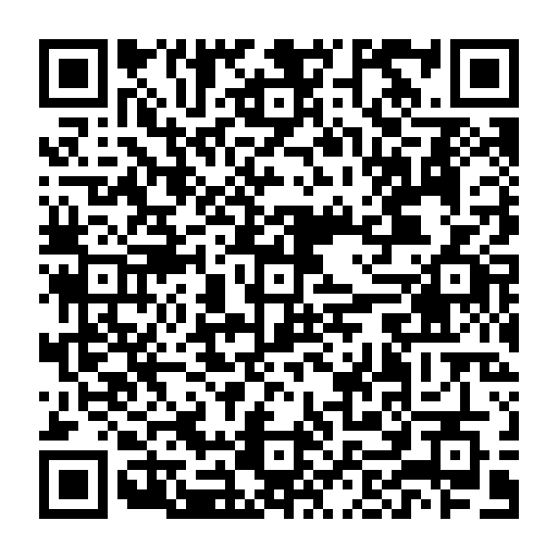
Lovely Professional University
Established by an Act of the Legislature of the State of Punjab, the Lovely Professional University Act, 2005
(Act No. 25 of 2005), and recognised by the University Grant Commission under Section 2(f) of the UGC Act. 1956
On recommendation of the Academic Council,
Lovely Professional University Admits
Gurpreet Singh
S/o Mr. Jagtar Singh and Ms. Baljeet Kaur
to the
Bachelor of Business Administration
in the First Division having completed the prescribed requirements in online education mode in the year 2020.
Given under the seal of the University at Phagwara, Punjab, India.
Scan for Verification
Registrar Vice Chancellor Chancellor
Certificate Number : 345927 Registration Number : 11801056
This Degree can be verify by scanning the attached QR Code.
Lovely Professional University
Jalandhar-Delhi G.T. Road,
Phagwara, (Punjab) India-14411.
Ph: +91-1824-520990
Website: www.lpu.in

